Slide 1



capstone project-Youtube
View in Power BI
Last data refresh:
12/26/2024 7:37:26 AM UTC
Downloaded at:
12/26/2024 4:00:42 PM UTC

Slide 2
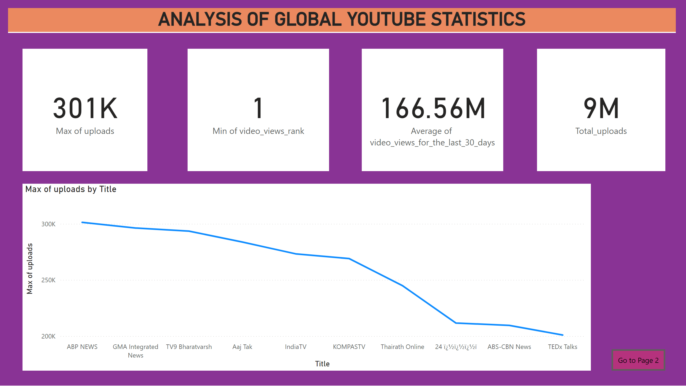
Page 1
Notes:
card
No alt text provided
card
No alt text provided
card
No alt text provided
lineChart
No alt text provided
card
No alt text provided
actionButton
No alt text provided
ANALYSIS OF GLOBAL YOUTUBE STATISTICS
No alt text provided

Slide 3
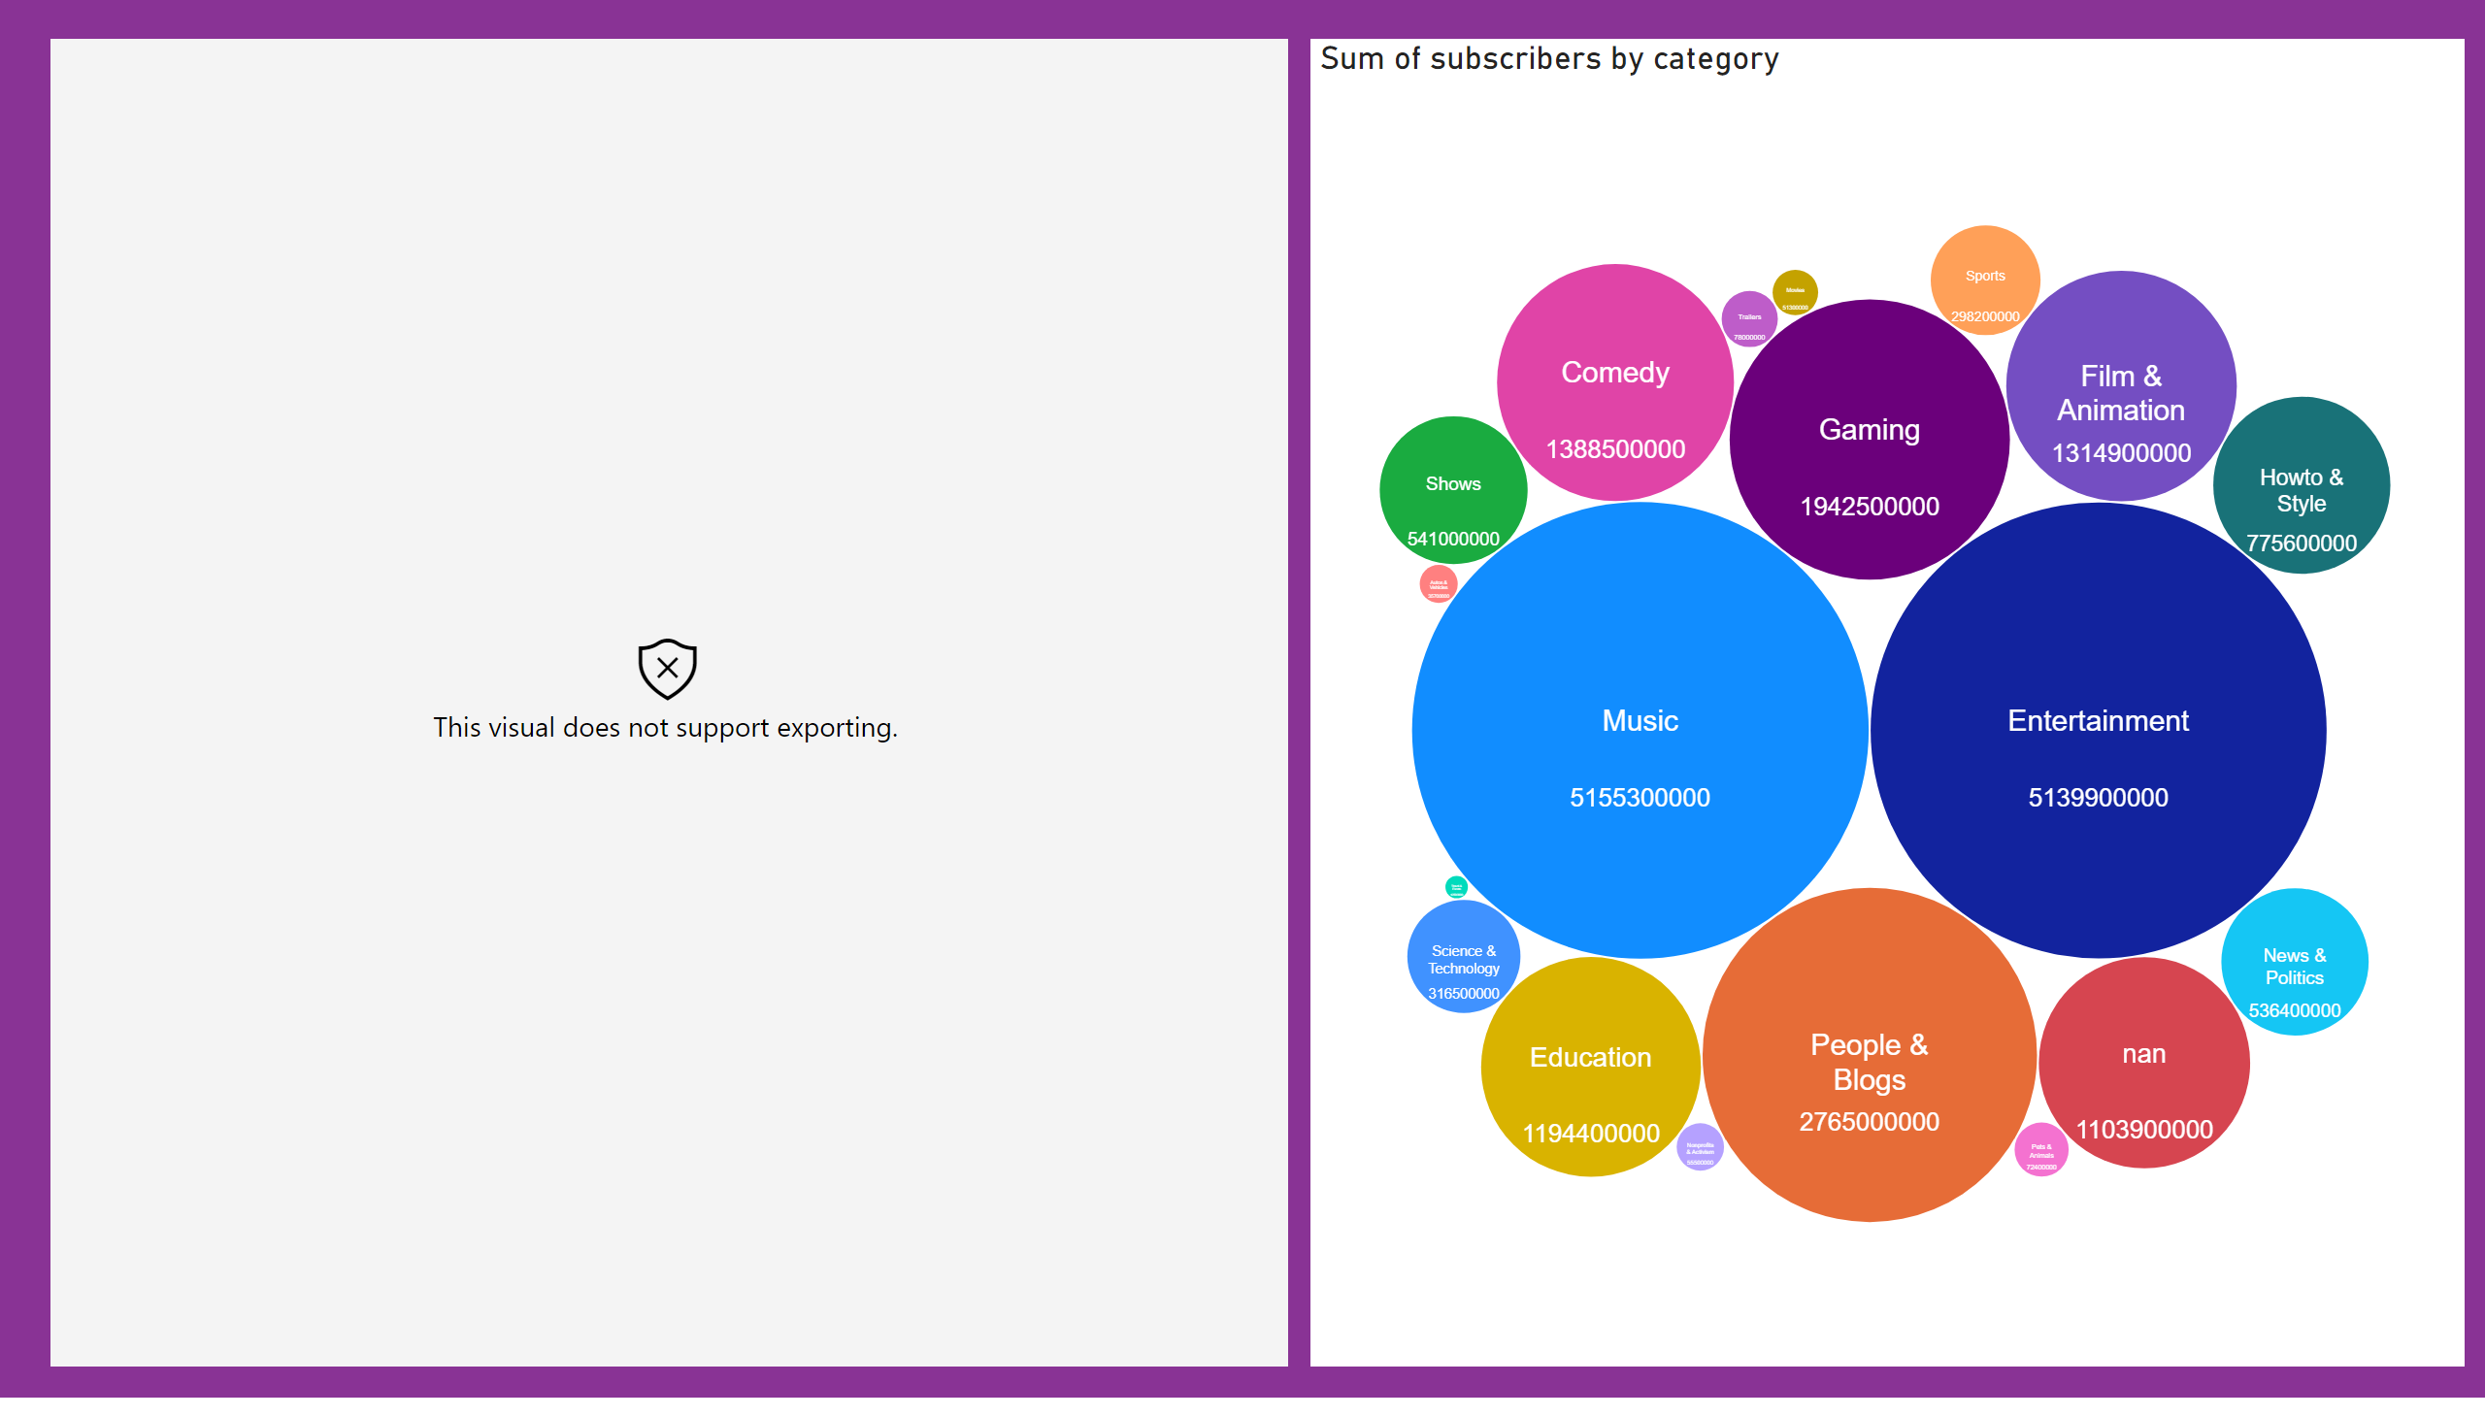
Page 2
Notes:
radarChart
No alt text provided
PackedBubbleChart
No alt text provided

Slide 4
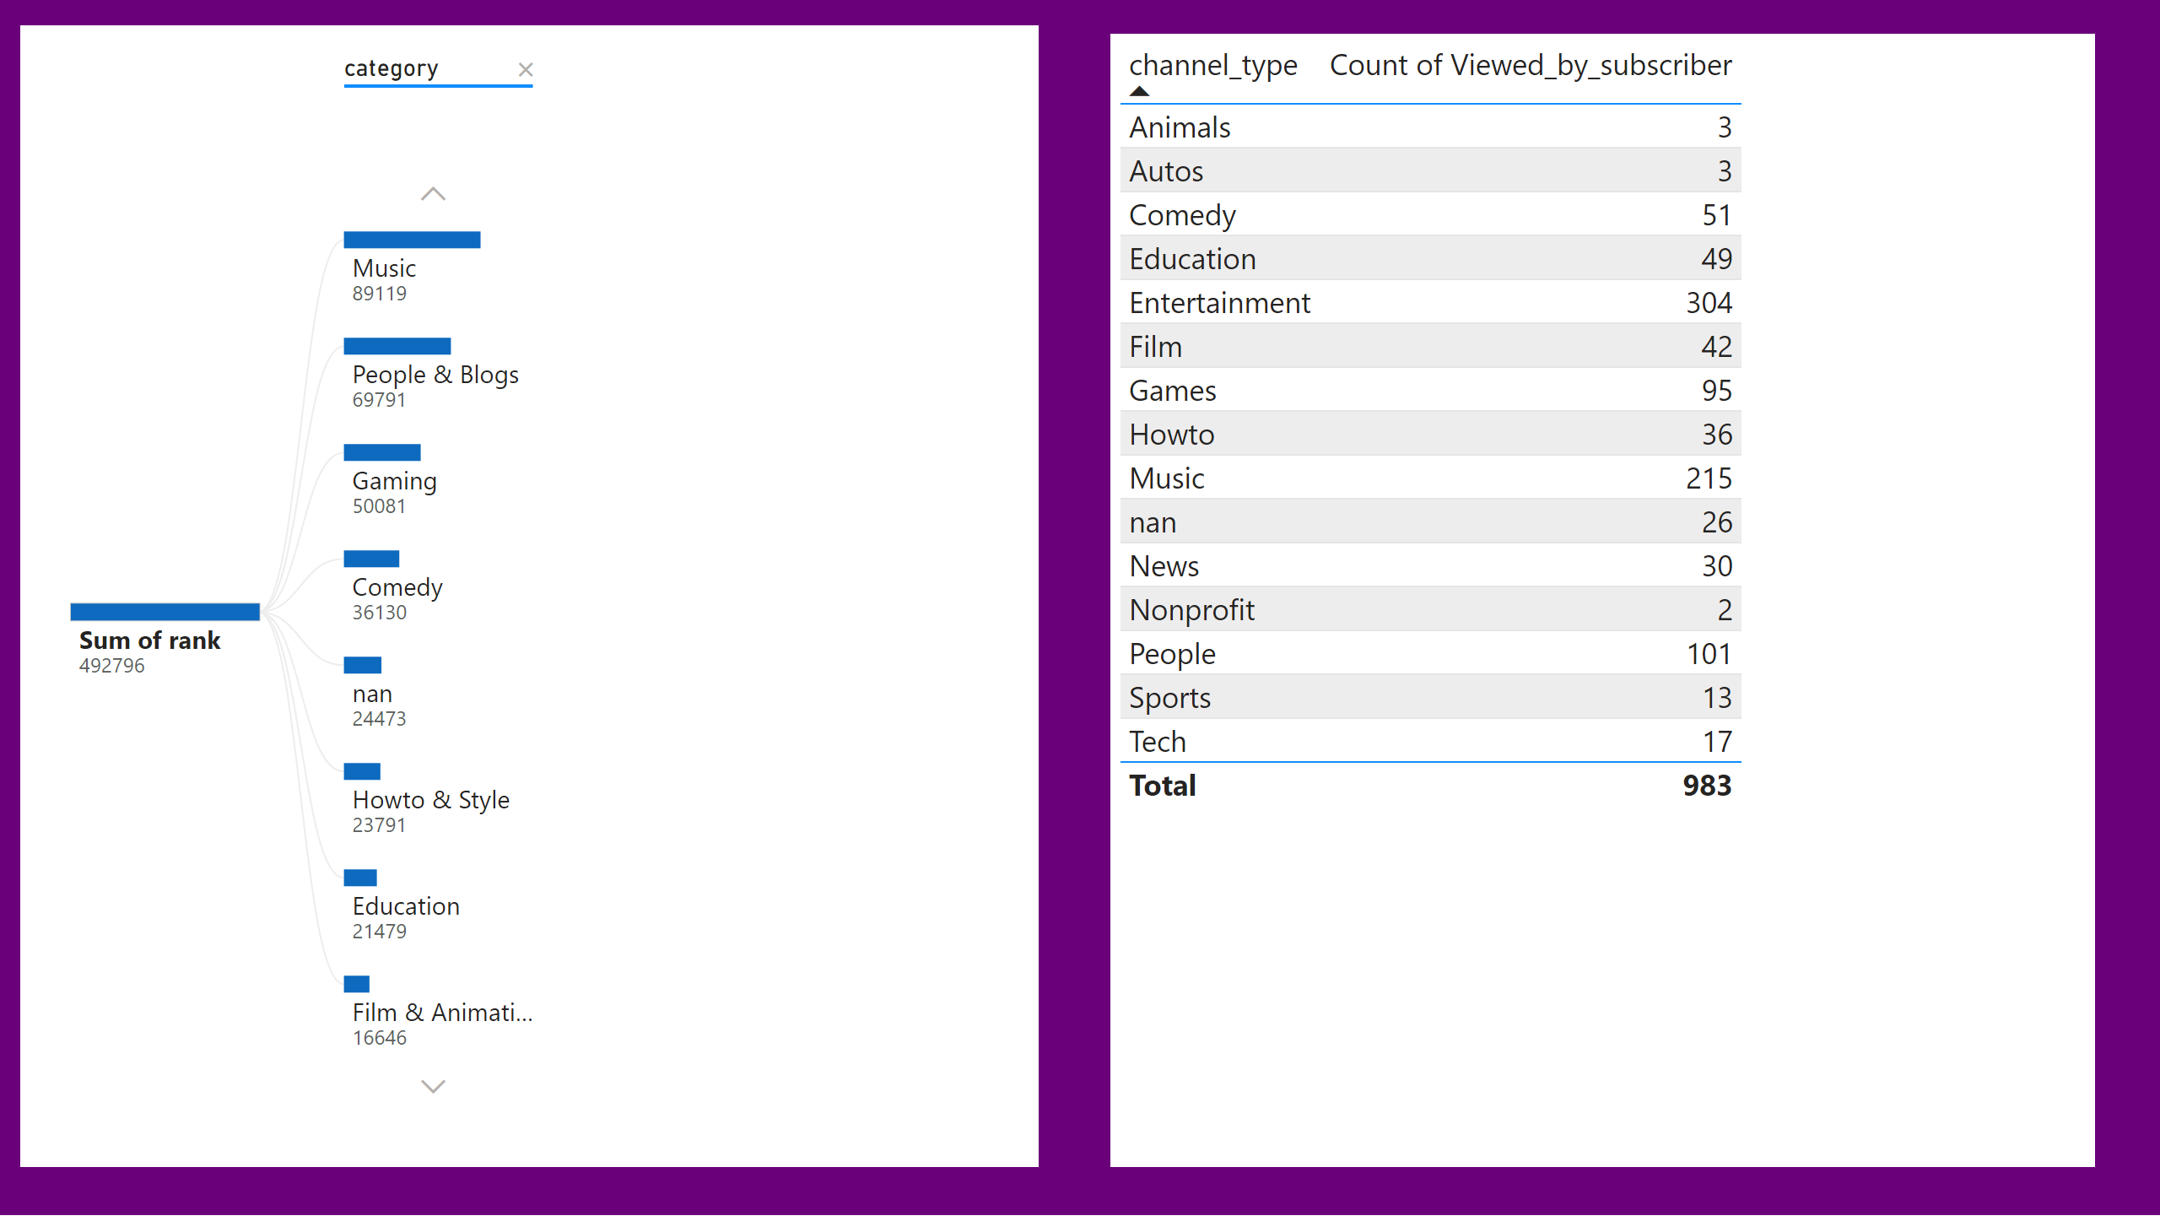
Page 3
Notes:
decompositionTreeVisual
No alt text provided
tableEx
No alt text provided

